Slide 1

Maya Manipulators
Kristine Middlemiss, Developer Consultant
Autodesk Developer Network (ADN)

Slide 2
Maya Manipulators
What is a manipulator?
A node that draws itself using 3D graphical elements that respond to user events. An intuitive way to change a node’s attribute.
Examples: swissArmyManip

Slide 3
Base Manipulators & API class:
Maya Standard Manipulators: MFnManip3D
FreePointTriadManip: MFnFreePointTriadManip
RotateManip: MFnRotateManip
ScaleManip: MFnScaleManip
DirectionManip: MFnDirectionManip
DistanceManip: MFnDistanceManip
DiscManip: MFnDiscManip
PointOnCurveManip: MFnPointOnCurveManip
PointOnSurfaceManip: MFnPointOnSurfaceManip
CircleSweepManip: MFnCircleSweepManip
ToggleManip: MFnToggleManip
StateManip: MFnStateManip
CurveSegmentManip: MFnCurveSegmentManip

Slide 4
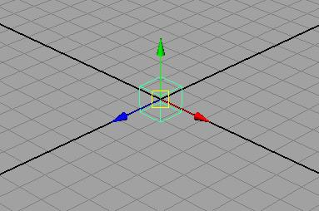
FreePointTriadManip

Slide 5
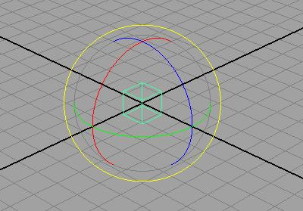
RotateManip

Slide 6
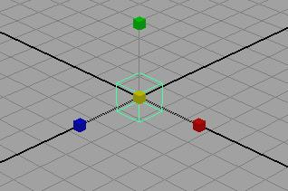
ScaleManip

Slide 7
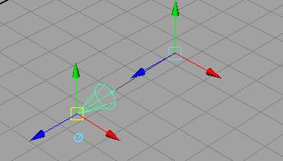
DirectionManip

Slide 8
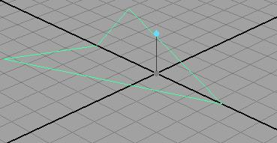
DistanceManip

Slide 9
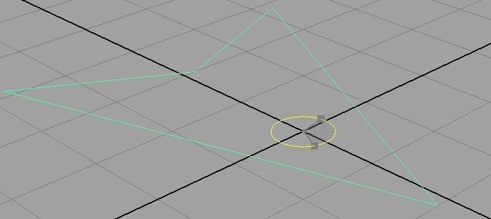
DiscManip

Slide 10
Custom Manipulator
Maya Standard Manipulators
Derived from MPxManipContainer
Container rather than a proxy manipulator
Can contain more than one base manipulator
Basic workflow:
add base manipulators to container
Set up associations between base manipulators and attributes

Slide 11
MPxManipContainer
Specify kManipContainer when registering the node in initializePlugin
MStatus initializePlugin(MObject obj) {
...
plugin.registerNode( "arrowLocatorManip", arrowLocatorManip::id, arrowLocatorManip::creator,
arrowLocatorManip::initialize, MPxNode::kManipContainer );
...
}
Add OpenMayaUI.lib and opengl32.lib (optional) into linking libraries

Slide 12
Example: arrowLocatorManip
class arrowLocatorManip : public MPxManipContainer
{
public:
arrowLocatorManip();
virtual ~arrowLocatorManip();
static void* creator();
static MStatus initialize();
virtual MStatus createChildren();
virtual MStatus connectToDependNode(const MObject &dependNode);
virtual void draw(M3dView &view, const MDagPath &path, M3dView::DisplayStyle style, M3dView::DisplayStatus status);
public:
static MTypeId id;
static MDagPath fDiscManip;
};

Slide 13
MPxManipContainer
Key functionalities:
add base manipulators:
MPxManipContainer::createChildren()
make associations between manipulators and attributes on nodes:
MPxManipContainer::connectToDependNode()
customize the drawing of your manipulator:
MPxManipContainer::draw()

Slide 14
Add Base Manipulators
MPxManipContainer::createChildren()
MStatus arrowLocatorManip::createChildren() {
...
MString manipName("angleManip");
MString angleName("yRotation");
fDiscManip = addDiscManip(manipName,angleName);
MPoint startPoint(0.0, 0.0, 0.0);
MAngle startAngle(0.0,MAngle::kDegrees);
MFnDiscManip fnDisc(fDiscManip,&status);
fnDisc.setCenterPoint(startPoint);
fnDisc.setAngle(startAngle);
...
}

Slide 15
Communications between Manipulators and Nodes
Container Manipulator
base manip
Converter
converterManipValue items
?
node
?
base manip
?
plug
manipValue
items
converterPlugValue items

Slide 16
Communications between Manipulators and Nodes
Two types:
One-to-one association
Conversion functions
MPxManipContainer::connectToDependNode()

Slide 17
Communications between Manipulators and Nodes
Container Manipulator
base manip
Converter
converterManipValue items
one-to-one association
node
base manip
plug
manipValue
items
converterPlugValue items

Slide 18
One-to-one Association
One-to-one associations are established through methods on the manipulator classes derived from MFnManip3D
Every standard manipulator has functions called “connectTo**Plug”
MFnFreePointTriadManip::connectToPointPlug
MFnDirectionManip::connectToDirectionPlug
MFnDistanceManip::connectToDistancePlug
MFnPointOnCurveManip::connectToCurvePlug
…
….
MFnScaleManip::connectToScaleCenterPlug

Slide 19
Example: arrowLocatorManip
MStatus arrowLocatorManip::connectToDependNode(const MObject &dependNode)
{
MStatus status = MStatus::kSuccess;
//Connect the plug with manip
MFnDependencyNode fnDepNode(dependNode);
MPlug rotationPlug = fnDepNode.findPlug(MString("windDirection"),&status);
MFnDiscManip fnDisc(fDiscManip,&status);
status = fnDisc.connectToAnglePlug(rotationPlug);
status = finishAddingManips();
status = MPxManipContainer::connectToDependNode(dependNode);
return status;
}

Slide 20
Example: arrowLocatorManip
In this project, you will need to create a manipulator on the arrowLocator and set up the one-to-one relationship between the manipulator item value and the plug value on your node.

Slide 21
Communications between Manipulators and Nodes
Container Manipulator
base manip
Converter
converterManipValue items
one-to-one association
node
Conversion function (manipToPlug)
base manip
plug
Conversion function (plugToManip)
manipValue
items
converterPlugValue items

Slide 22
Conversion Functions
Convert between manipulator values and plug values
Implemented as callback methods
Two kinds of conversion callbacks:
manipToPlug
addManipToPlugConversionCallback (MPlug &plug, manipToPlugConversionCallback callback)
plugToManip
addPlugToManipConversionCallback (unsigned int manipIndex, plugToManipConversionCallback callback)
MManipData
converterManipValues
converterPlugValues
converterPlugValues
converterManipValues

Slide 23
Example:arrowLocatorManip
MStatus arrowLocatorManip::connectToDependNode(const MObject &dependNode)
{ ….
MFnDependencyNode fnDepNode(dependNode);
MPlug rotationPlug = fnDepNode.findPlug(MString("windDirection"),&status);
MFnDiscManip fnDisc(fDiscManip,&status);
status = fnDisc.connectToAnglePlug(rotationPlug);
unsigned int centerPointIndex = fnDisc.centerIndex(&status);
addPlugToManipConversionCallback(centerPointIndex,
(plugToManipConversionCallback)&arrowLocatorManip::centerPointCallback);
….
}

Slide 24
Example:arrowLocatorManip
MManipData arrowLocatorManip::centerPointCallback(unsigned int manipIndex)
{
MStatus status;
//Retrieve world space translation of the locator node
MObject parentTransform = fNodePath.transform(&status);
MDagPath transformPath;
MDagPath::getAPathTo(parentTransform,transformPath);
MFnTransform fnTrans(transformPath,&status);
MVector translation = fnTrans.getTranslation(MSpace::kWorld,&status);
MFnNumericData numData;
MObject numDataValue = numData.create(MFnNumericData::k3Double,&status);
status = numData.setData3Double(translation.x,translation.y,translation.z);
MManipData manipData(numDataValue);
return manipData;
}

Slide 25
MPxManipContainer::draw()
void moveManip::draw(M3dView &view, const MDagPath &path, M3dView::DisplayStyle style, M3dView::DispalyStatus status) {
MPxManipContainer::draw(view, path, style, status);
view.beginGL();
MPoint textPos(0, 0, 0);
char str[100];
sprintf(str, "Stretch Me!");
MString distanceText(str);
view.drawText(distanceText, textPos, M3dView::kLeft);
view.endGL();
}

Slide 26
Invoke manipulators
Show Manipulator tool
Manipulator named after node type name
arrowLocator → arrowLocatorManip
In custom node’s initialize(), call MPxManipContainer::addToManipConnectTable(MTypeId &id)
Custom Context

Slide 27
Manipulators and Contexts
MPxManipContainer::newManipulator ( const MString & manipName, MObject & manipObject, MStatus * ReturnStatus = NULL )
MPxContext::addManipulator(const MObject &manipulator)
MPxContext::deleteManipulators()
MPxContext::toolOnSetup()
MPxContext::toolOffCleanup()

Slide 28
Example: moveManip project
MCallbackId id1;
void moveContext::toolOnSetup(MEvent &)
{ ….
updateManipulators(this);
MStatus status;
id1 = MModelMessage::addCallback(MModelMessage::kActiveListModified, updateManipulators, this, &status);
….
}
void moveContext::toolOffCleanup()
{
...
status = MModelMessage::removeCallback(id1);
...
}

Slide 29
Example: moveManip project
void MoveManipContext::updateManipulators(void * data)
{
...
moveContext * ctxPtr = (moveContext *) data;
ctxPtr->deleteManipulators();
...
// for each object selected
MString manipName("moveManip");
MObject manipObject;
ctxPtr->moveM = (moveManip *) moveManip::newManipulator(manipName,manipObject);
...
ctxPtr->addManipulator(manipObject);
...
ctxPtr->moveM->connectToDependNode(dependNode);
...
}

Slide 30
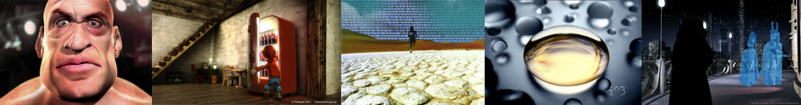
Major Limitation
Cannot create a custom manipulator that:
Plug-in draws itself
Maya performs selection on manipulator components
MPxManipulatorNode: openGL draw and selection
Autodesk Media & Entertainment

Slide 31
Q & A

Slide 32
Autodesk

